Slide 1
Building an Excellent & Compliant Cybersecurity Posture
Dr. Jose Neto
PhD-Cybersecurity

Slide 2
Agenda
Transitioning to CMMC v2
Common mistakes observed in dozens of Defense contractors
Understanding deployment challenges
Building on top of an existing IT infrastructure
Tailored design vs. cookie-cutter security approach
Researching an effective sequence for deployment
Achieving a perfect DIBCAC Audit score (110/110)
Our secret formula
Leveraging a proven methodology

Slide 3
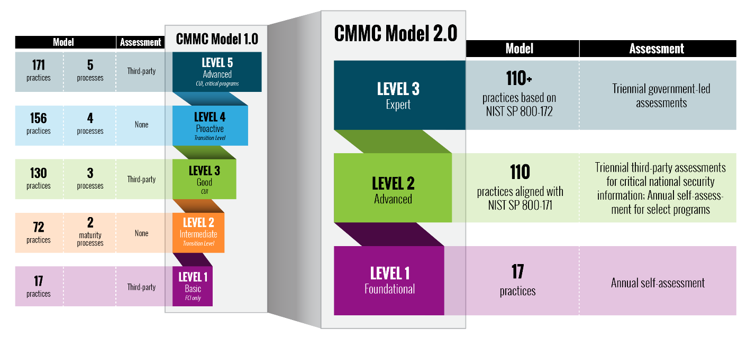
CMMC v2

Slide 4
Self-Assessments
Level 1 Foundational & a subset of Level 2 Advanced will conduct annual self-assessments.
Level 2 assessment determination is based on involvement with sensitive national security information.
Assessment results will be affirmed by a senior company official and updated in Supplier Performance Risk System (SPRS).

Slide 5
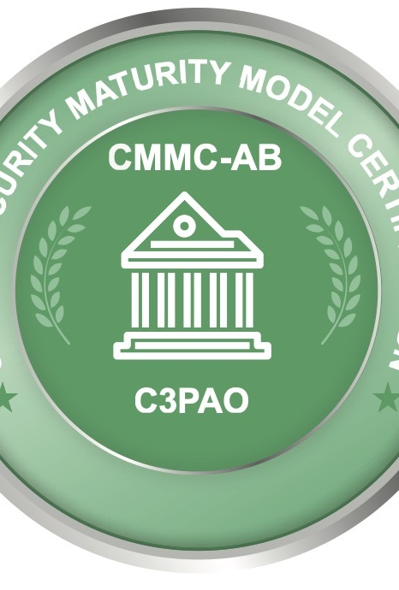
Third-party Assessments
The organization will be responsible to coordinating the assessment with a Third-Party Assessment Organizations (C3PAOs).
DoD will only accept CMMC assessments provided by an authorized and accredited C3PAO

Slide 6
Government assessments
Level 3 (“Expert”) cybersecurity requirements to be assessed by government officials.
Triennial third-party assessments
CMMC certificates and third-party assessment data will be stored in the CMMC Enterprise Mission Assurance Support Services (eMASS) database.

Slide 7
Common mistakes observed in dozens of Defense contractors
Incorrect interpretation of security requirements. Abstract compliance language can be subjective.
Security requirements are planned and deployed individually rather than holistically.
Key stakeholders not having visibility throughout the entire deployment process
Comprehensive formal testing conducted at the end of the deployment.
Opposition to embrace security solutions for lack of convenience

Slide 8
Building on top of an existing IT infrastructure
The most important step in the initial planning phase is truly understanding the existing IT infrastructure.
This extends beyond the popular “GAP Analysis”, the security team must have intricate technical knowledge of the system’s capabilities and limitations.
Just having a compliance metric of what is deficient from the GAP Assessment will not provide a comprehensive technical roadmap for effective security solutions.

Slide 9
Tailored security design vs. cookie-cutter security approach
Each security solution must be carefully selected and researched before procurement.
Standalone security products may provide limited protection effectively but may create conflicts with other security solutions as a collective.
Tailored security design must factor the scope of the CUI mission, the size of the company, the minimum operating baseline for the mission and the desired level of protection.

Slide 10
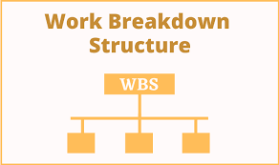
Researching an effective sequence for deployment
A detailed deployment schedule should be created, detailing the sequence of implementation for each security solution.
Incorrectly planning this phase can create technical conflicts that will delay the process and demand additional time and human capital to correct.

Slide 11
Getting a perfect DIBCAC Audit score (110/110)
Notes:
Defense Industrial Base Cybersecurity Assessment Center

Slide 12
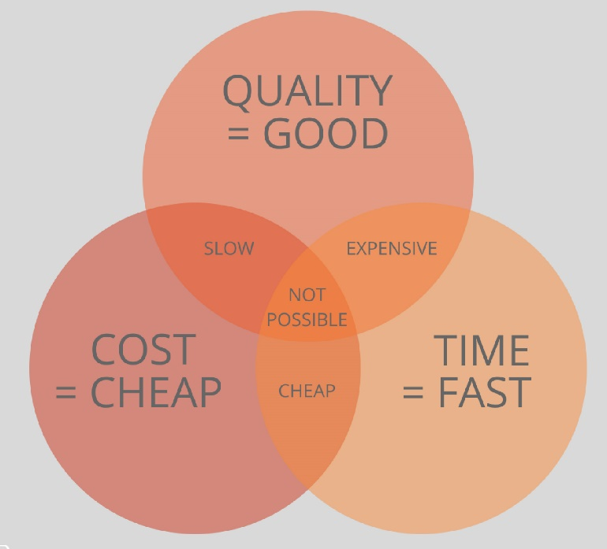
Compliance Conundrum
At best, organizations can get two out of the three.

Slide 13
Common constraints
Time-Constraints based on upcoming compliance assessments.
Lack of established formal security documentation
Information System Security Manager (ISSM) lacking government compliance understanding.
Ad hoc approach to procuring and deploying security solutions.
Lack of security training on the resulting IT infrastructure and cybersecurity posture.

Slide 14
Our Secret Formula
Allocate enough time (6 months to a year), based on the current cybersecurity posture.
Establish a team of both technical and government compliance SMEs to work in tandem.
Don’t rush the planning phase, as this will expedite the procurement and deployment process.
Document the processes, create artifacts, and compile a detailed System Security Plan (SSP).
Conduct training on the different security solutions and their capabilities.

Slide 15
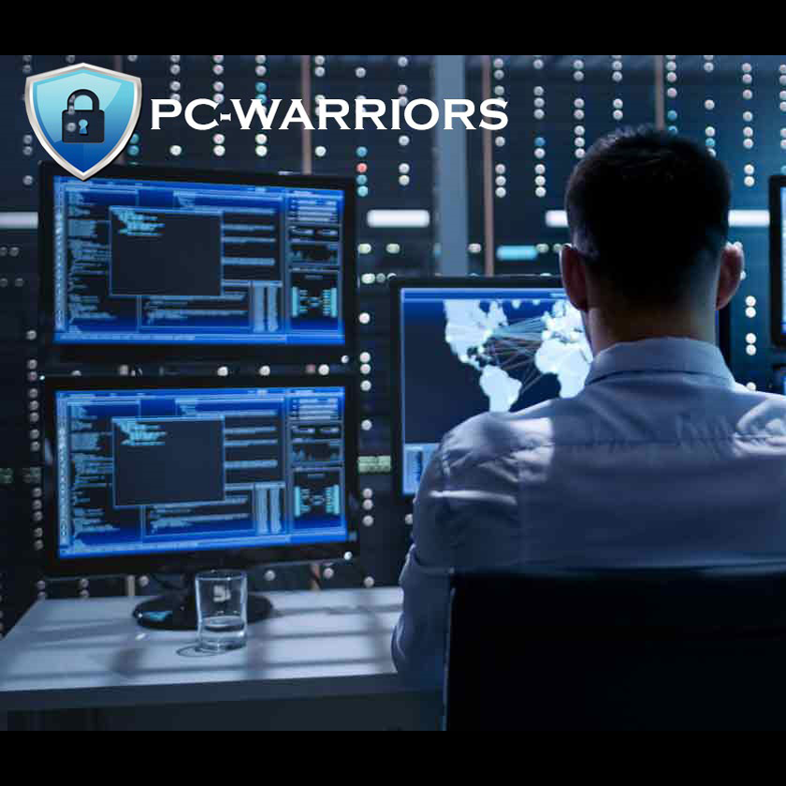
Sustainment
After the desired cybersecurity posture is obtained, the in-house ISSM and security team must perform ongoing monitoring of the infrastructure and all the required activities.

Slide 16
Questions ?
Thank you for your time!!
Dr. Jose Neto
JNeto@PC-Warriors.com

Slide 17
Leveraging a proven methodology
Cybersecurity Compliance Express (CCE) program
After identifying the challenges and inefficiencies in the cybersecurity compliance journey, we decided to develop a methodical approach that can deliver excellent results.
We have two tracks for deployment:
Six-months compliance track
Twelve-months compliance track
For more information, contact us.
https://PC-Warriors.com

